Slide 1
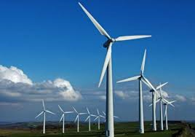
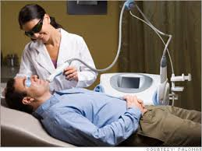
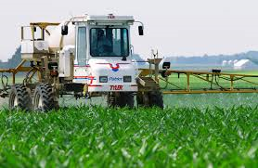
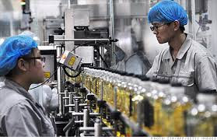
Learning Targets: I can… 1. Define and identify the 7 areas of technology in my own words. 2. Explain how each area of technology is important to our society. 3. Create a PowerPoint presentation with a new slide design and images which align with each technology.
Do Now: How is technology important to our society?
Demonstration
Lab time
Save file as:
7 Areas of Technology_ Your name
Check

Slide 2
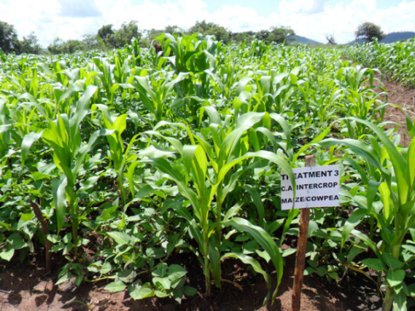
Learning Targets: I can… 1. Define and identify the 7 areas of technology in my own words.
2. Explain how Agricultural and Biotechnology is important to our society. 3. Create a PowerPoint presentation with a new slide design and images which align with each technology.
Agricultural and Biotechnology
Developing and using devices and systems to plant, grow, and harvest crops.
Video: Farm On: Sustainable Food Production

Slide 3
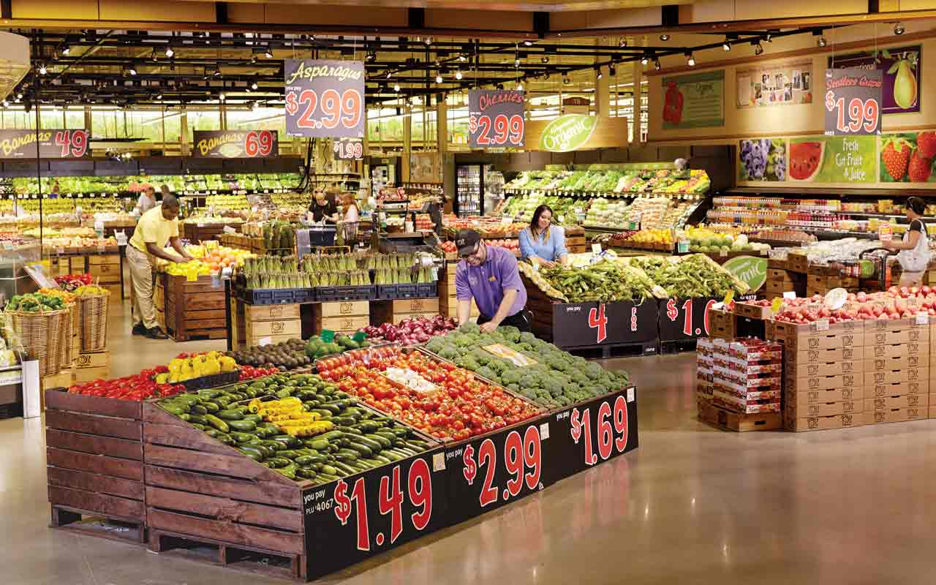
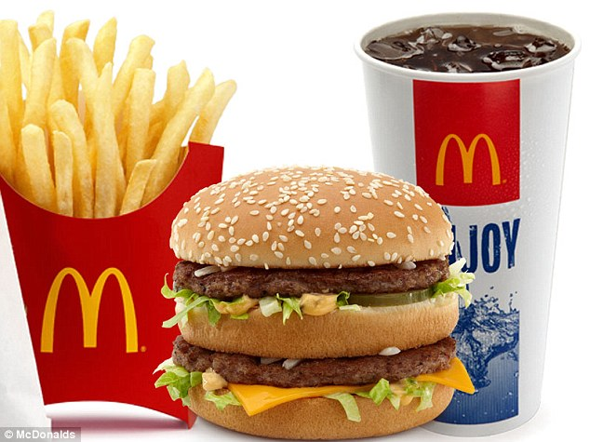
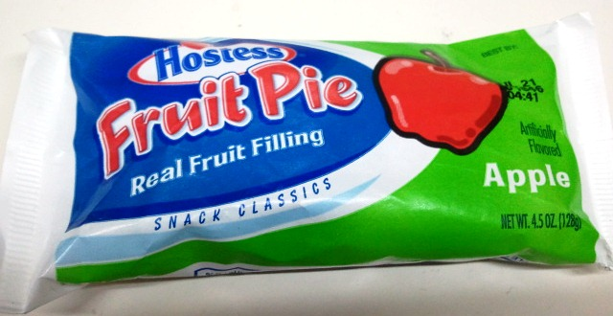
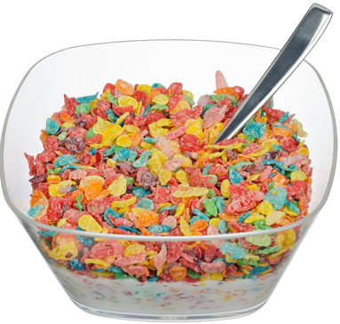
Learning Targets: I can… 1. Define and identify the 7 areas of technology in my own words.
2. Explain how Agricultural and Biotechnology is important to our society. 3. Create a PowerPoint presentation with a new slide design and images which align with each technology.
Agricultural and Biotechnology

Slide 4
Learning Targets: I can… 1. Define and identify the 7 areas of technology in my own words.
2. Explain how Information and Communication Technology is important to our society. 3. Create a PowerPoint presentation with a new slide design and images which align with each technology.
Information and Communication Technology
Developing and using devices and systems to gather, process, share information, and share ideas.
Video: From Stone Age to Tech Age
Video: New Communication Technologies

Slide 5
Learning Targets: I can… 1. Define and identify the 7 areas of technology in my own words.
2. Explain how Information and Communication Technology is important to our society. 3. Create a PowerPoint presentation with a new slide design and images which align with each technology.
Information and Communication Technology

Slide 6
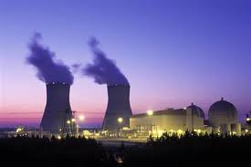
Learning Targets: I can… 1. Define and identify the 7 areas of technology in my own words.
2. Explain how Energy and Power Technology is important to our society. 3. Create a PowerPoint presentation with a new slide design and images which align with each technology.
Energy and Power Technology
Developing and using devices and systems to convert, transmit, or process energy.
Video: Fossil Fuels 101 (Non-renewable)
Video: Renewable Energy 101 – National Geographic
Video: Renewable Energy Explained in 2 ½ Minutes

Slide 7
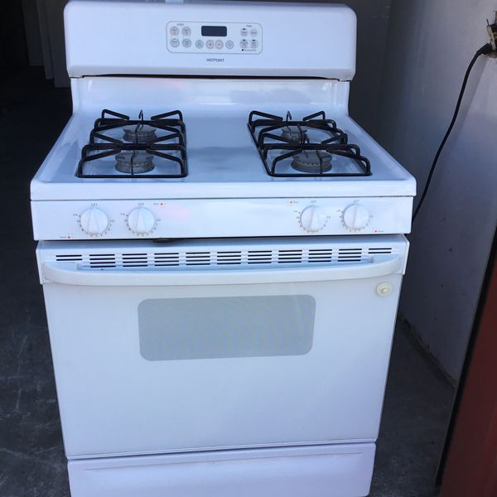
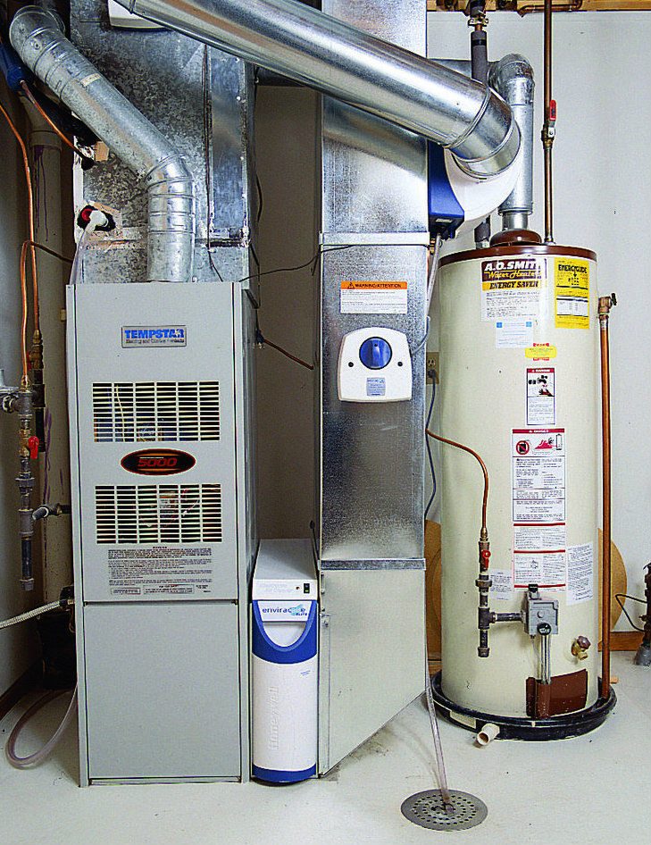
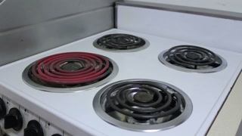
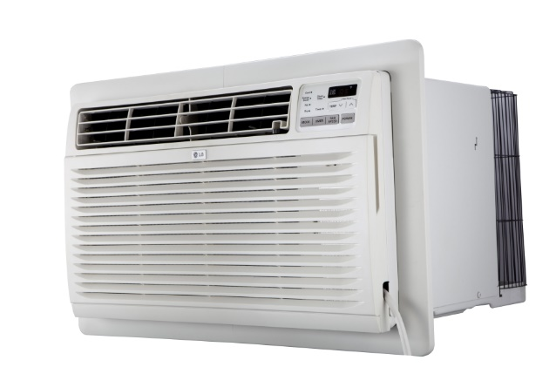
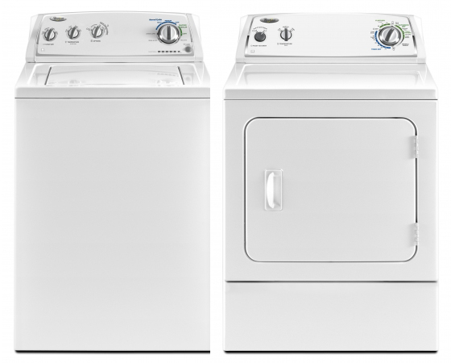
Learning Targets: I can… 1. Define and identify the 7 areas of technology in my own words.
2. Explain how Energy and Power Technology is important to our society. 3. Create a PowerPoint presentation with a new slide design and images which align with each technology.
Energy and Power Technology
What is the technology? What is the fuel (energy) source?

Slide 8
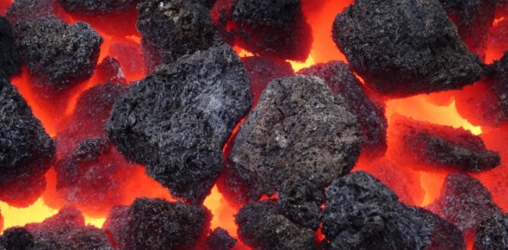
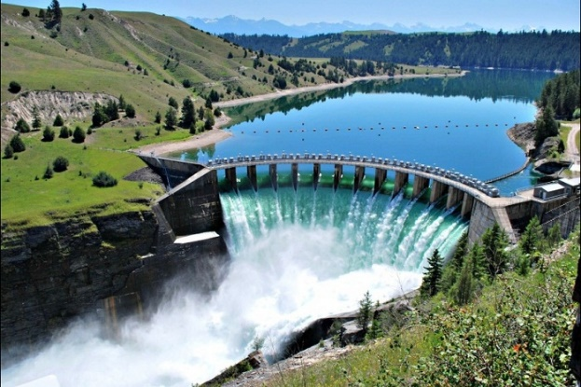
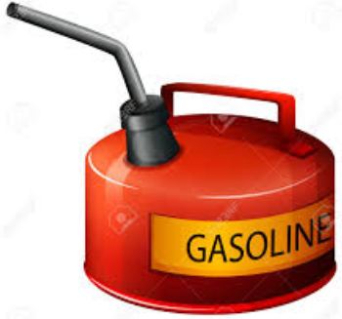
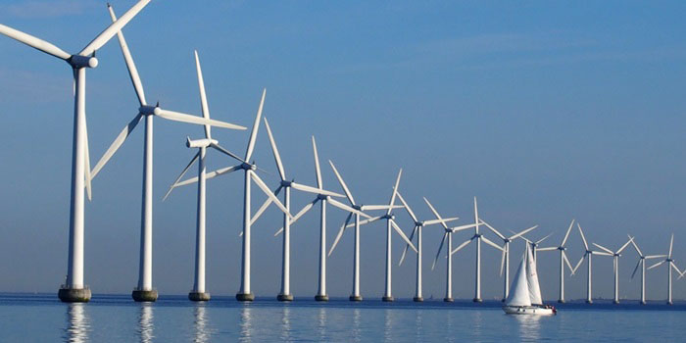
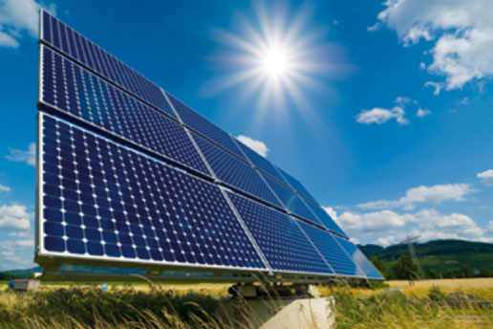
Learning Targets: I can… 1. Define and identify the 7 areas of technology in my own words.
2. Explain how Energy and Power Technology is important to our society. 3. Create a PowerPoint presentation with a new slide design and images which align with each technology.
Energy and Power Technology

Slide 9
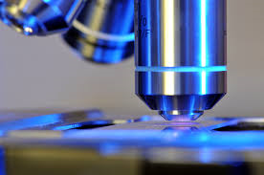
Learning Targets: I can… 1. Define and identify the 7 areas of technology in my own words.
2. Explain how Medical Technology is important to our society. 3. Create a PowerPoint presentation with a new slide design and images which align with each technology.
Medical Technology
Developing and using devices and systems to promote health and cure illness.
Video: Top 10 Medical Breakthroughs

Slide 10
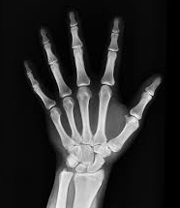
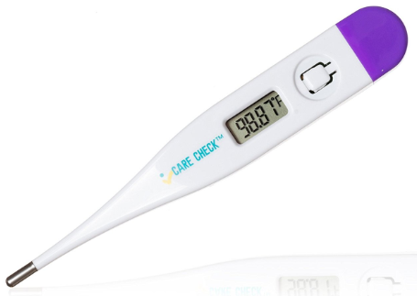
Learning Targets: I can… 1. Define and identify the 7 areas of technology in my own words.
2. Explain how Medical Technology is important to our society. 3. Create a PowerPoint presentation with a new slide design and images which align with each technology.
Medical Technology

Slide 11
Learning Targets: I can… 1. Define and identify the 7 areas of technology in my own words.
2. Explain how Construction Technology is important to our society. 3. Create a PowerPoint presentation with a new slide design and images which align with each technology.
Construction Technology
Using systems and processes to put structures on the sites where they will be used.
Video: Building for the Future: Construction Trades Class
Video: Welcome to the School of Construction

Slide 12
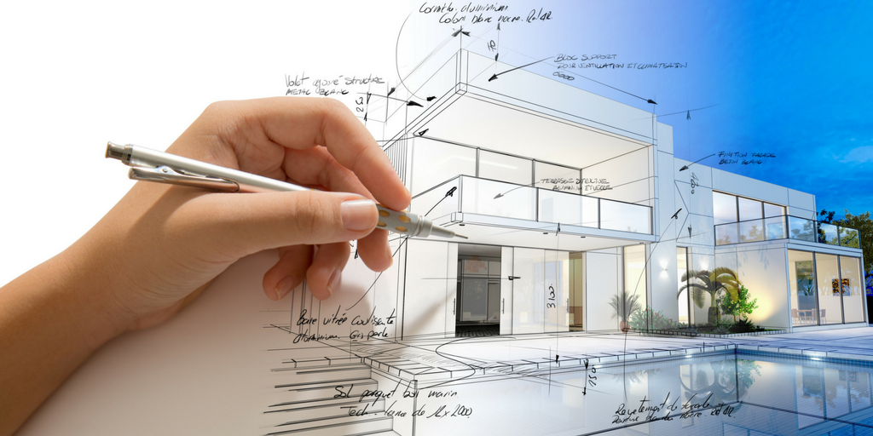
Learning Targets: I can… 1. Define and identify the 7 areas of technology in my own words.
2. Explain how Construction Technology is important to our society. 3. Create a PowerPoint presentation with a new slide design and images which align with each technology.
Construction Technology

Slide 13
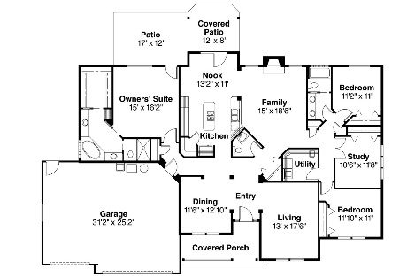
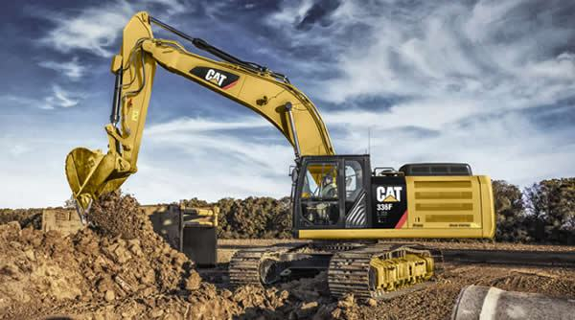
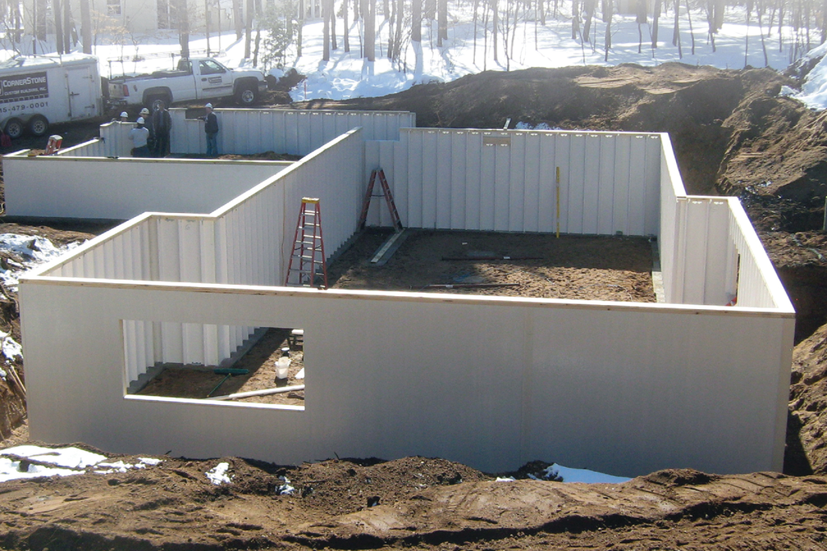
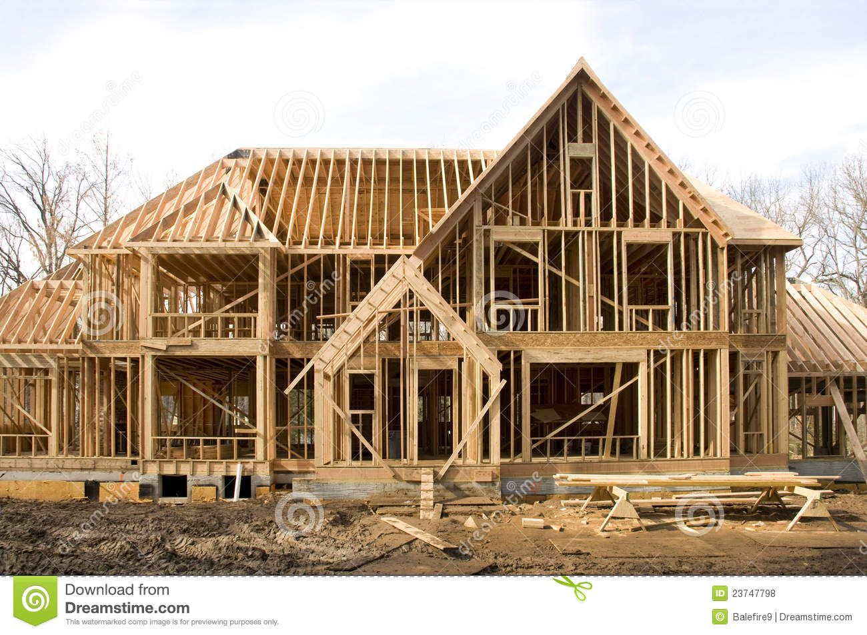
Construction Technology
Learning Targets: I can… 1. Define and identify the 7 areas of technology in my own words.
2. Explain how Construction Technology is important to our society. 3. Create a PowerPoint presentation with a new slide design and images which align with each technology.

Slide 14
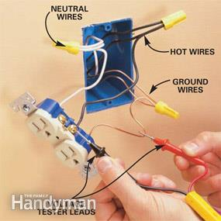
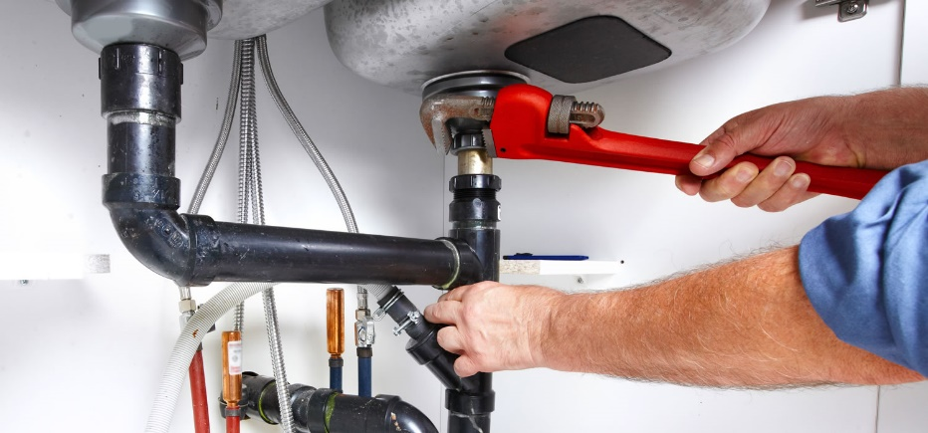
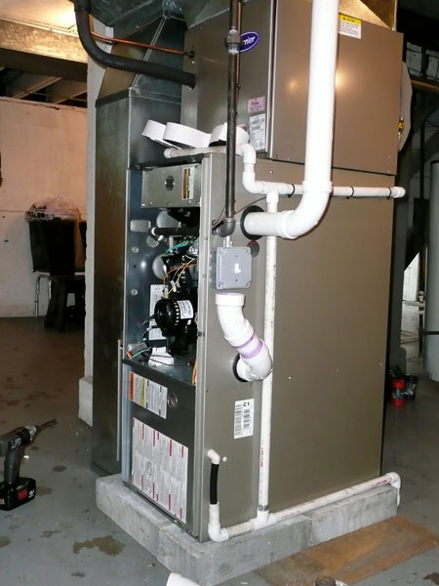
Learning Targets: I can… 1. Define and identify the 7 areas of technology in my own words.
2. Explain how Construction Technology is important to our society. 3. Create a PowerPoint presentation with a new slide design and images which align with each technology.
Construction Technology

Slide 15
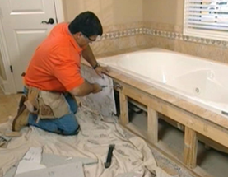
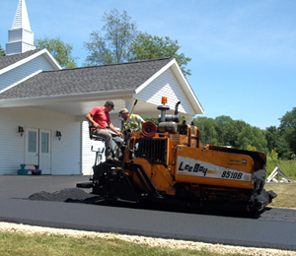
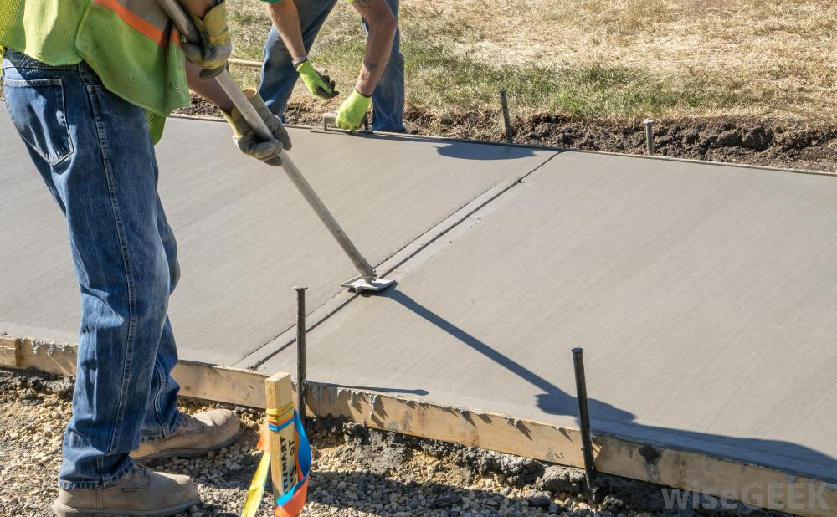
Learning Targets: I can… 1. Define and identify the 7 areas of technology in my own words.
2. Explain how Construction Technology is important to our society. 3. Create a PowerPoint presentation with a new slide design and images which align with each technology.
Construction Technology

Slide 16
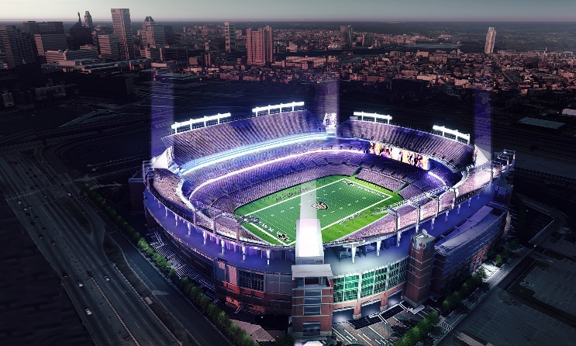
Learning Targets: I can… 1. Define and identify the 7 areas of technology in my own words.
2. Explain how Construction Technology is important to our society. 3. Create a PowerPoint presentation with a new slide design and images which align with each technology.
Construction Technology

Slide 17
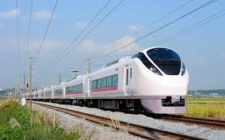
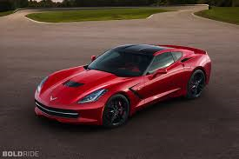
Learning Targets: I can… 1. Define and identify the 7 areas of technology in my own words.
2. Explain how Transportation Technology is important to our society. 3. Create a PowerPoint presentation with a new slide design and images which align with each technology.
Transportation Technology
Developing and using devices and systems to move people and cargo from an origin point to a destination.
Video: An Animated History of Transportation

Slide 18
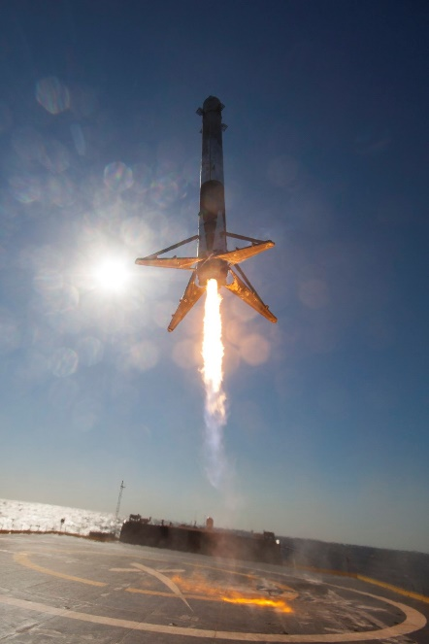
Learning Targets: I can… 1. Define and identify the 7 areas of technology in my own words.
2. Explain how Transportation Technology is important to our society. 3. Create a PowerPoint presentation with a new slide design and images which align with each technology.
Transportation Technology

Slide 19
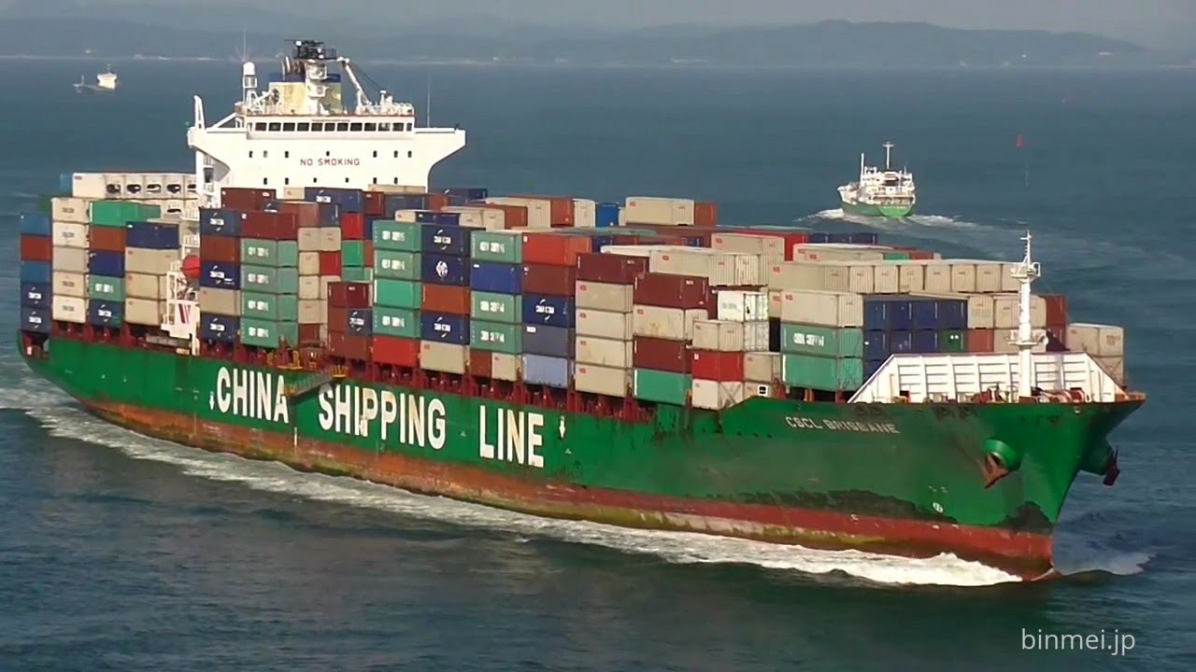
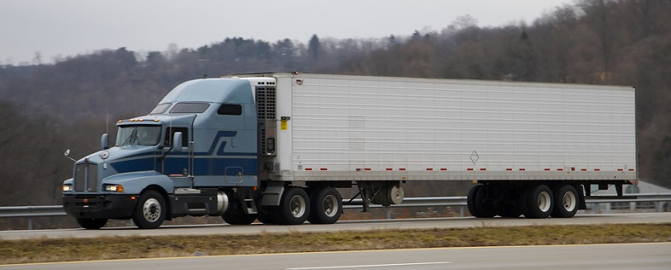
Learning Targets: I can… 1. Define and identify the 7 areas of technology in my own words.
2. Explain how Transportation Technology is important to our society. 3. Create a PowerPoint presentation with a new slide design and images which align with each technology.
Transportation Technology

Slide 20
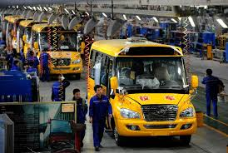
Learning Targets: I can… 1. Define and identify the 7 areas of technology in my own words.
2. Explain how Manufacturing Technology is important to our society. 3. Create a PowerPoint presentation with a new slide design and images which align with each technology.
Manufacturing Technology
Developing and using devices, systems and processes to convert materials into products in a factory.
Video: Fundamentals of Manufacturing Processes
Video: BrainPOP-Assembly line

Slide 21
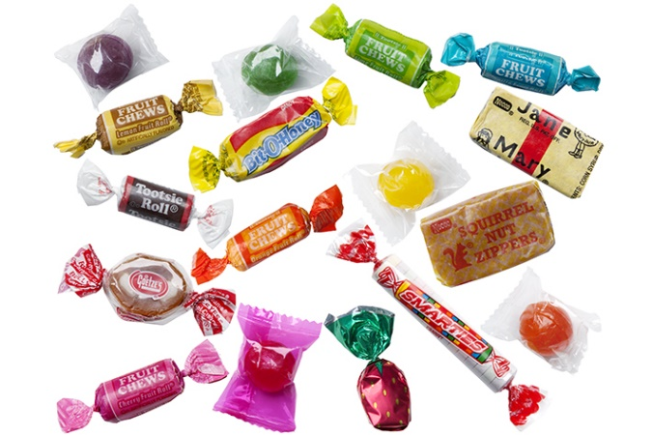
Learning Targets: I can… 1. Define and identify the 7 areas of technology in my own words.
2. Explain how Manufacturing Technology is important to our society. 3. Create a PowerPoint presentation with a new slide design and images which align with each technology.
Manufacturing Technology

Slide 22
Learning Targets: I can… 1. Define and identify the 7 areas of technology in my own words.
2. Explain how Manufacturing Technology is important to our society. 3. Create a PowerPoint presentation with a new slide design and images which align with each technology.
Manufacturing Technology

Slide 23
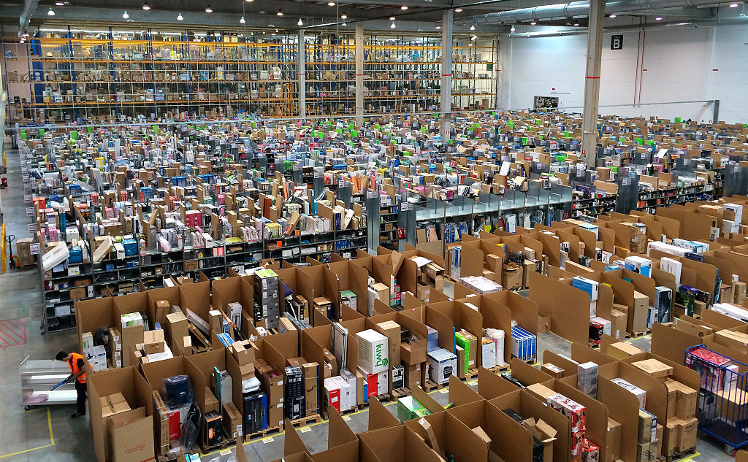
Learning Targets: I can… 1. Define and identify the 7 areas of technology in my own words.
2. Explain how Manufacturing Technology is important to our society. 3. Create a PowerPoint presentation with a new slide design and images which align with each technology.
Manufacturing Technology
Amazon Facility – Middletown, Delaware

Slide 24
Learning Targets: I can… 1. Summarize and discuss the multiple areas of technology and how they impact our society. 2. Choose an area of technology you would like to work in as career, and explain why you would like to work in that area. 3. Select multiple images simultaneously to copy and paste at another location. 4. Define and identify the 7 areas of technology, using Study Stack.
Conclusion:
Summarize and discuss the multiple areas of technology and how they impact our society.
Choose an area of technology you would like to work in as career, and explain why you would like to work in that area.

Slide 25
Learning Target: I can… 1. Self-assess my ‘7 Areas of Technology’ project, according to the rubric (criteria for success).
Slides | Meeting Expectations (10-9 pts) | Approaching Expectations (8-6 pts) | Not Meeting Expectations (5-0 pts)
Title Slide | Title, your name, subject, teacher’s name, 7 pictures – one from each area, balanced, neat, clean, professional | Missing 1-3 items | Missing 4 or more items, or did not finish
Agricultural and Biotechnology | Title, correct definition, correct explanation of importance to society, 5-6 pictures, balanced, neat, clean, professional | Missing 1-3 items | Missing 4 or more items, or did not finish
Information and Communication Technology | Title, correct definition, correct explanation of importance to society, 5-6 pictures, balanced, neat, clean, professional | Missing 1-3 items | Missing 4 or more items, or did not finish
Energy and Power Technology | Title, correct definition, correct explanation of importance to society, 5-6 pictures, balanced, neat, clean, professional | Missing 1-3 items | Missing 4 or more items, or did not finish
Medical Technology | Title, correct definition, correct explanation of importance to society, 5-6 pictures, balanced, neat, clean, professional | Missing 1-3 items | Missing 4 or more items, or did not finish
Construction Technology | Title, correct definition, correct explanation of importance to society, 5-6 pictures, balanced, neat, clean, professional | Missing 1-3 items | Missing 4 or more items, or did not finish
Transportation Technology | Title, correct definition, correct explanation of importance to society, 5-6 pictures, balanced, neat, clean, professional | Missing 1-3 items | Missing 4 or more items, or did not finish
Manufacturing Technology | Title, correct definition, correct explanation of importance to society, 5-6 pictures, balanced, neat, clean, professional | Missing 1-3 items | Missing 4 or more items, or did not finish
Conclusion | Accurately answers questions, 5+ complete sentences, no spelling or grammatical errors, 7 pictures – one from each area | Accurately answers questions, 3-4 complete sentences, some spelling or grammatical errors, 4-6 pictures | Does not answer questions, 0-2 complete sentences, several spelling or grammatical errors, 0-3 pictures
Self-Evaluation | Assigns a score for each slide, calculates total score, answers reflection question | Missing 1 item | Missing 2+ items
Total: _____/100 pts

